Slide 1
TaskBridge
Distributed computing for small tasks
https://gihub.com/hilderonny/taskbridge

Slide 2
Objectives
Basic idea from BOINC Framework
Scalable task processing
Extendable work types
Cost efficient
Simple usage
Data protection compliant

Slide 3



Network structure
Clients
Task Bridge
Workers
Set tasks
Process tasks
.
.
.
.
.
.

Slide 4
Task types
Transcribe media files (audio and video)
Translate text bewtween many languages
Classify images
Detect malicious files

Slide 5
Clients
TaskBridge Web-UI
IPED Task
NUIX Plugin
X-Ways Extension

Slide 6
Participants
Clients | Task Bridge | Workers
Web applications | Linux server | Portable scripts
Plugins for commercial software | Undemanding | Windows, Linux
Undemanding |  | Good GPU recommended

Slide 7
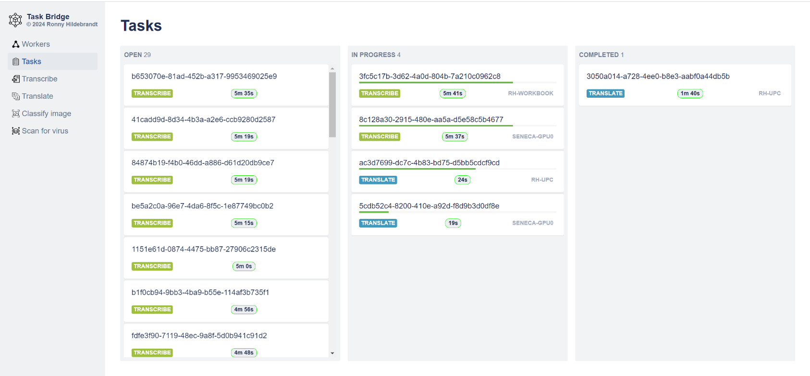
Task Bridge Web UI - Tasks

Slide 8
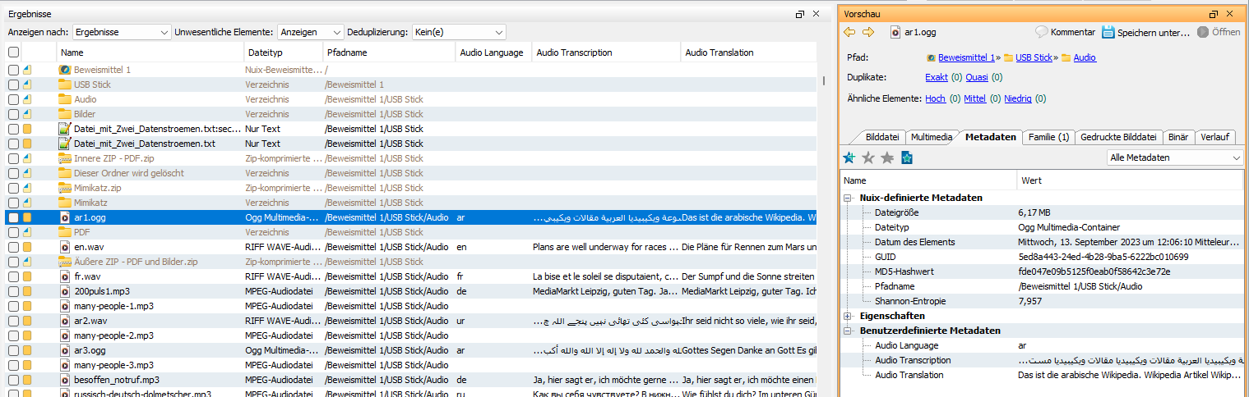
Clients – NUIX Plugin

Slide 9
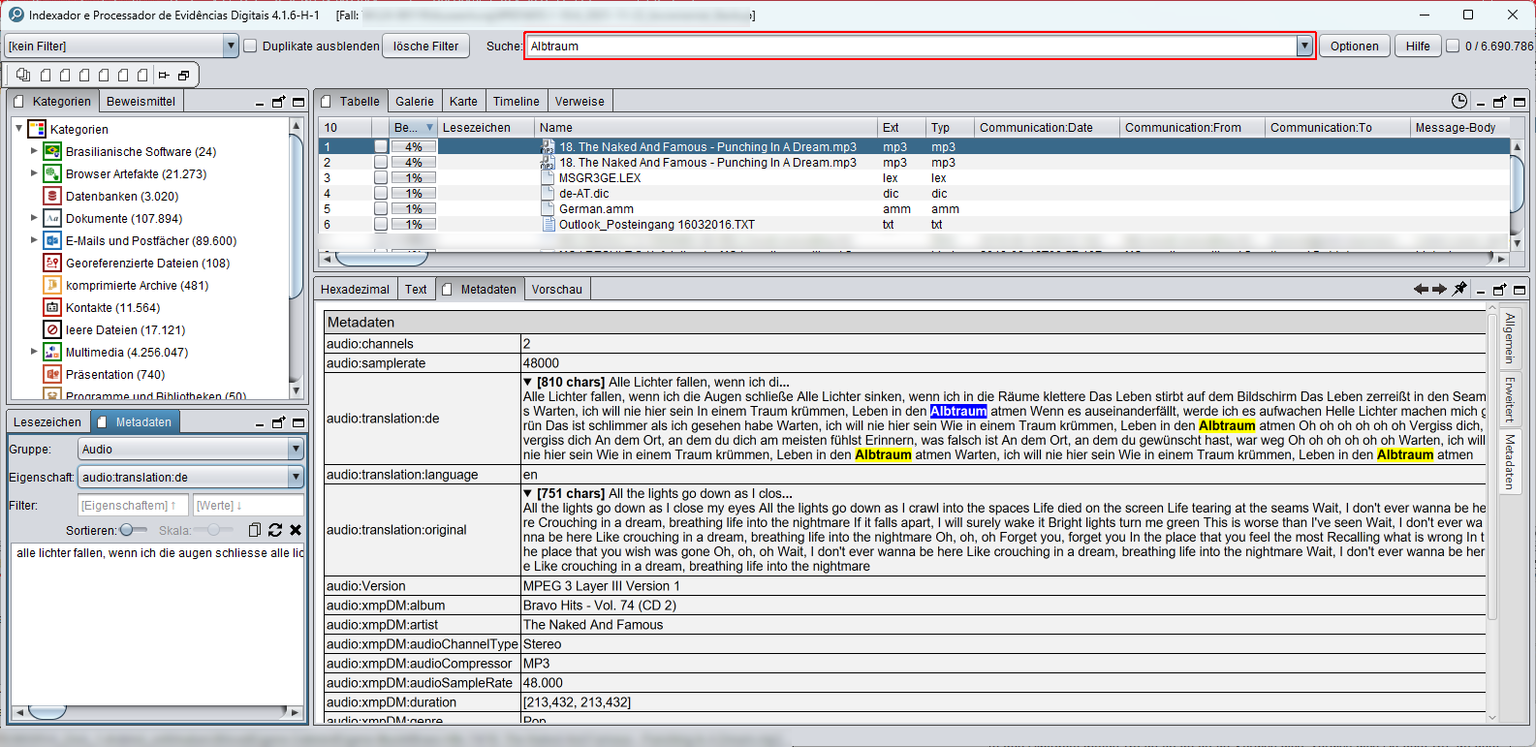
Clients – IPED Task

Slide 10
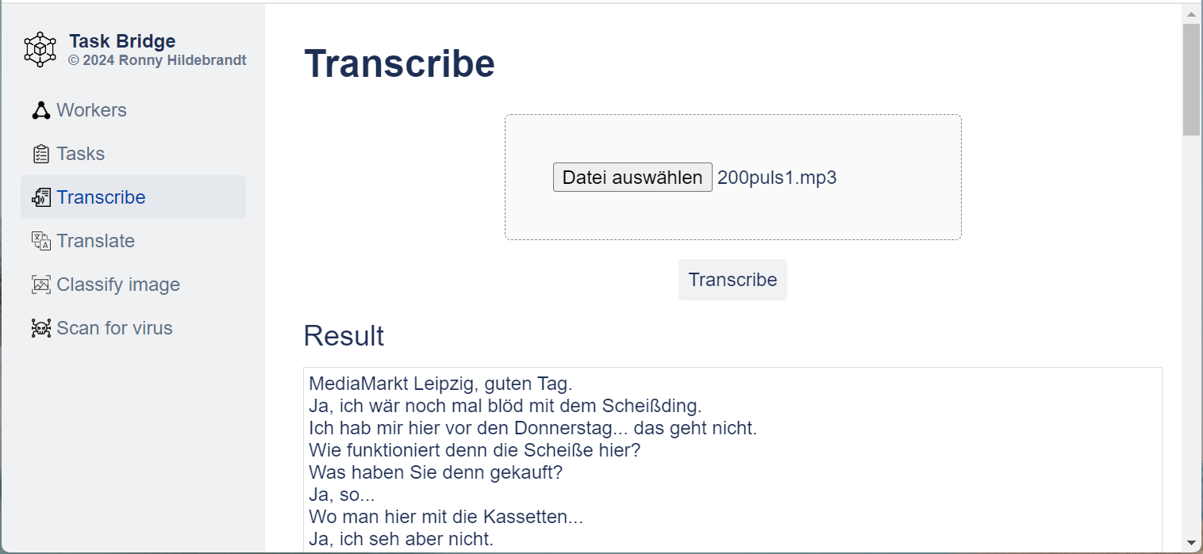
Clients – Web UI – Transcribe

Slide 11
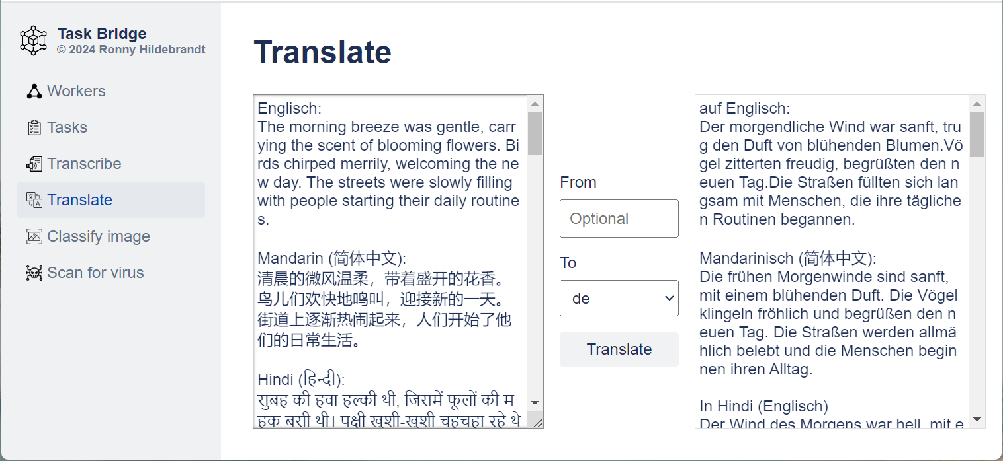
Clients – Web UI – Translate

Slide 12
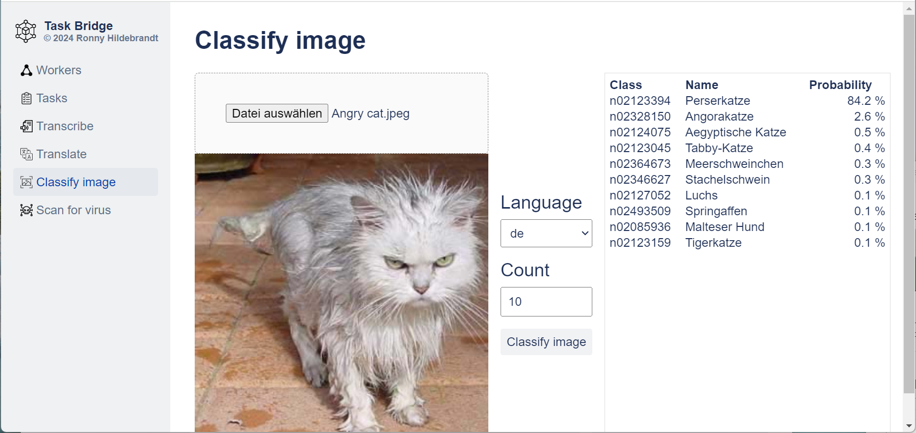
Clients – Web UI – Classify image

Slide 13
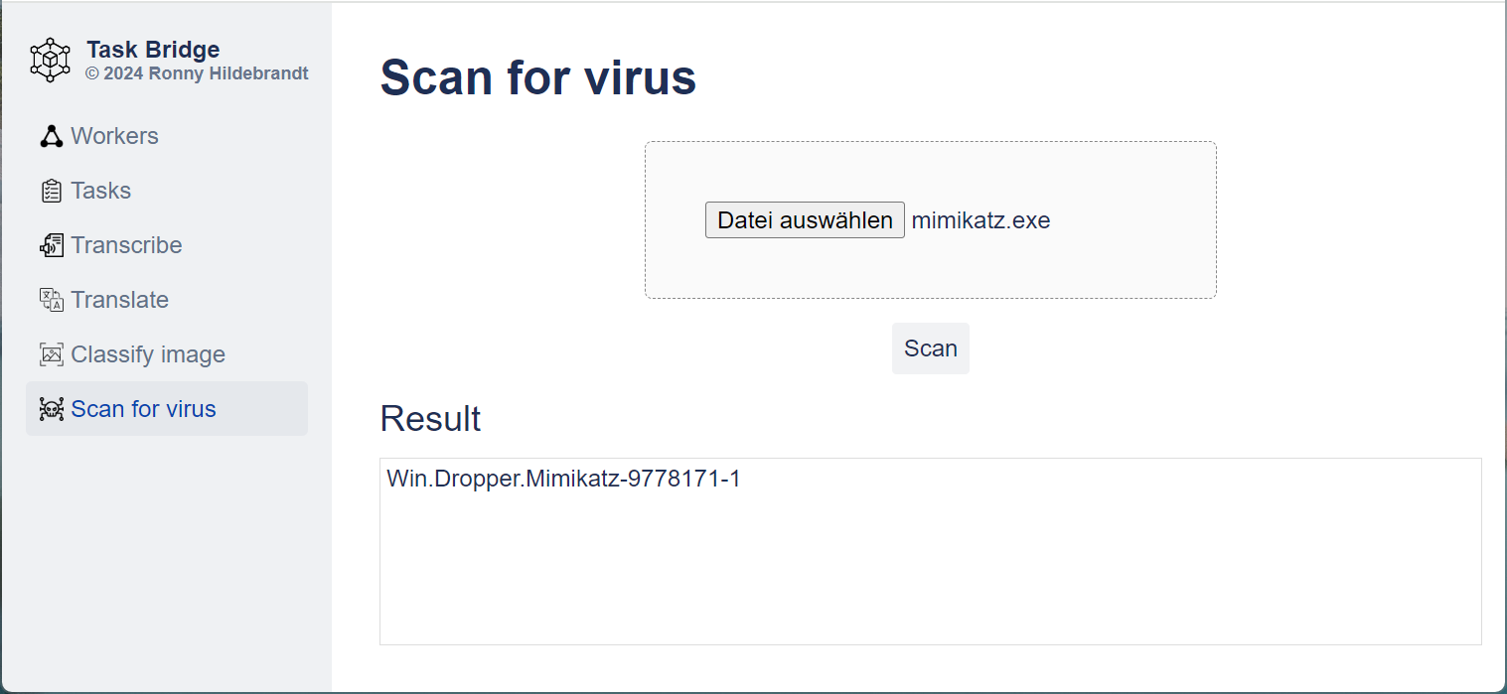
Clients – Web UI – Scan for virus

Slide 14
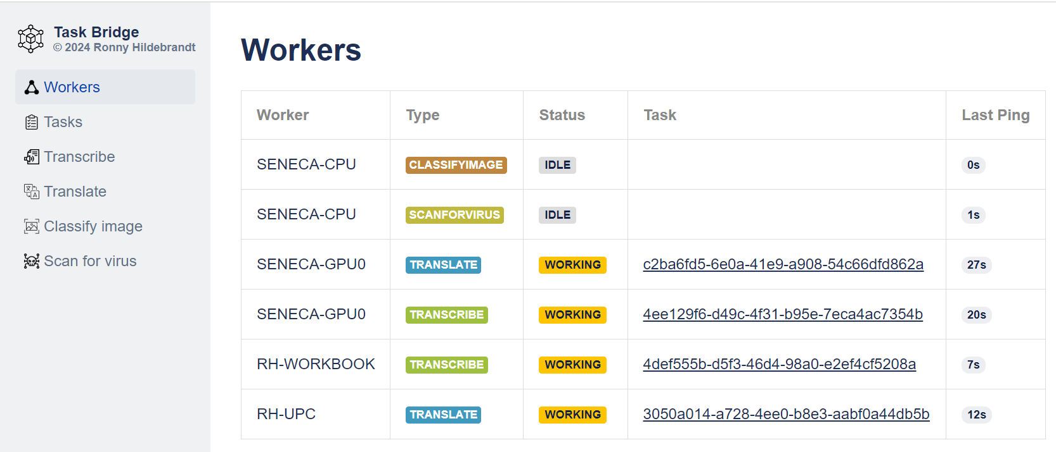
Task Bridge Web UI – Workers

Slide 15
Summary
No internet connection required
Scalable without limits
Open Source - https://github.com/hilderonny
No additional costs

